Slide 1

Health Workforce Prediction Using Agricultural GDP
Big Data Analytics Capstone Project
KARENZI Prince
Course: INSY 8413
Date: July 2025

Slide 2








Data & Analysis Approach
Dataset
Pipeline
World Bank indicators (2010-2023)
Raw Data
67 countries, 5 key variables
Cleaning
Tools
EDA
Python
Pandas, Scikit-learn
Linear Regression
Power BI Dashboard
Power BI
Data visualization

Slide 3
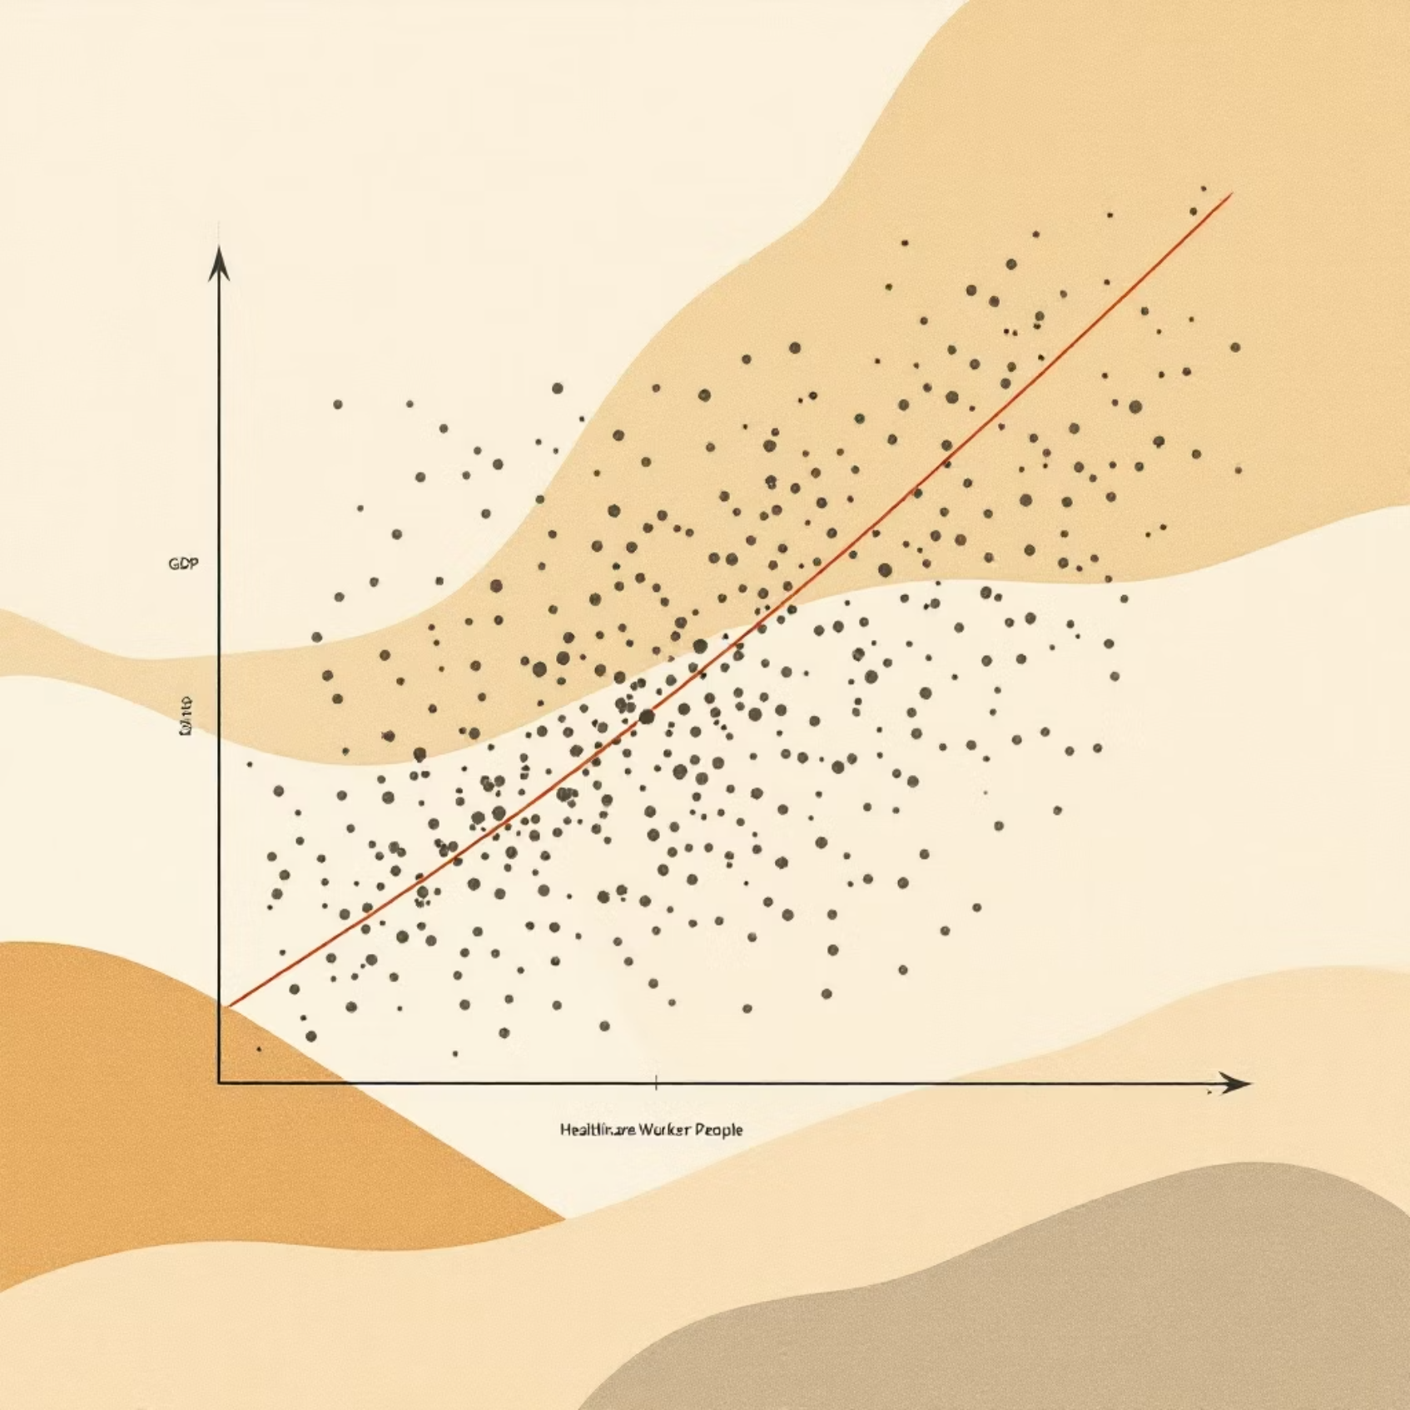
Key Findings
Model Performance
0.82
0.76
R² Value
Correlation (ρ)
Strong predictive power
Between Agri. GDP and health workers
"Every 1% ↑ in Agri. GDP → 0.5 ↑ health workers/1000"
Top 3 Insights
Strong correlation (ρ = 0.76)
Rwanda outperforms predictions by 12%
Urbanization reduces effect size
Plotly scatter plot visualization

Slide 4
Actionable Insights
For Policymakers
Future Work
1
1
Prioritize health funding
COVID-19 Impact
In countries with Agri. GDP > 15%
Incorporate pandemic data into models
2
2
Focus on rural areas
Advanced Models
Where urban population < 50%
Test neural network models for improved prediction

